Slide 1

The (un?) reasonable effectiveness of mathematics in computer programming
Gabriel Claramunt
Scalents

Slide 2
“This story is based on actual events. In certain cases incidents, characters and timelines have been changed for dramatic purposes”

Slide 3

“The Unreasonable Effectiveness of Mathematics in the Natural Sciences”

Slide 4
What about programming?

Slide 5
First, a story

Slide 6
As the 20th century dawned, Whitehead and Russell’s Principia Mathematica demonstrated that formal logic could express a large part of mathematics. Inspired by this vision, Hilbert and his colleagues at Gottingen became the leading proponents of formal logic, aiming to put it on a firm foundation

Slide 7
Consistency: proof that no contradiction can be obtained in the formalism.

Slide 8
Completeness: all true mathematical statements can be proved in the formalism.

Slide 9
Decidability: an algorithm deciding whether any statement is a theorem (Entscheidungsproblem)

Slide 10
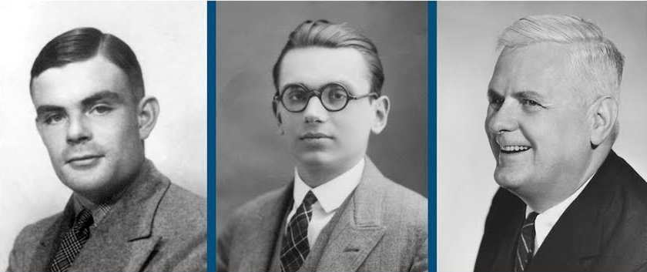
Kurt Gödel had bad news for them

Slide 11
First incompleteness theorem
"Any consistent formal system F within which a certain amount of elementary arithmetic can be carried out is incomplete; i.e., there are statements of the language of F which can neither be proved nor disproved in F."

Slide 12
Second incompleteness theorem
"Assume F is a consistent formalized system which contains elementary arithmetic. Then F ⊬ Cons ( F )

Slide 13
Hilbert’s Program was to solve the Entscheidungsproblem (decision problem), that is, to develop an “effectively calculable” procedure to determine the truth or falsity of any statement.

Slide 14
Alonso Church
Lambda Calculus

Slide 15
Thoroughly unsatisfactory!
Kurt Gödel

Slide 16
Kurt Gödel
Recursive functions

Slide 17
Alan M. Turing
Computing machines
(aka Turing Machines)

Slide 18
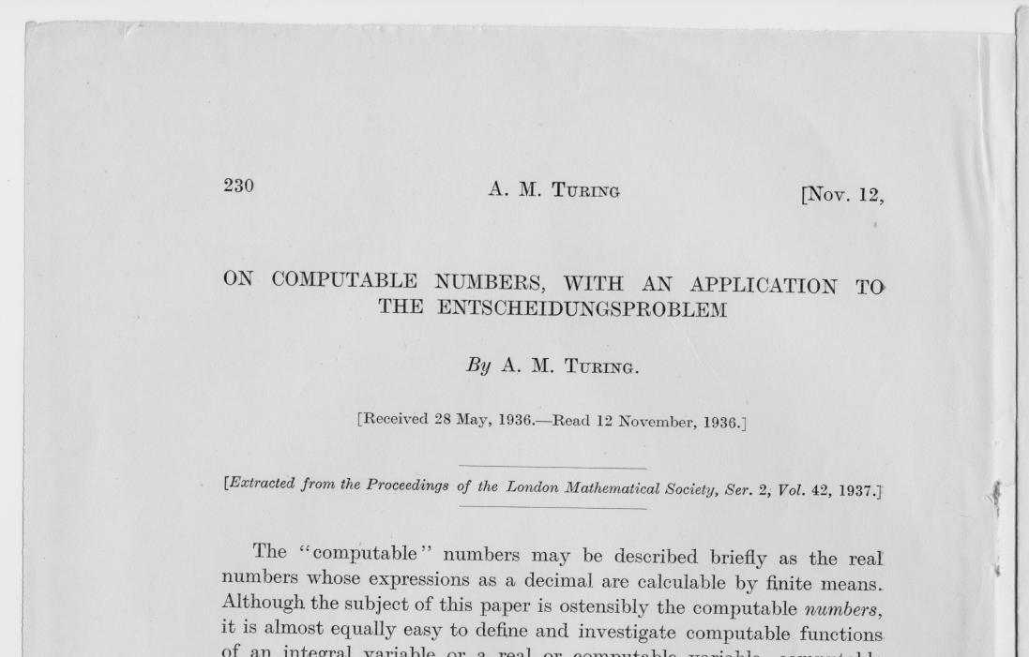

Slide 19
Most satisfactory!
Kurt Gödel

Slide 20
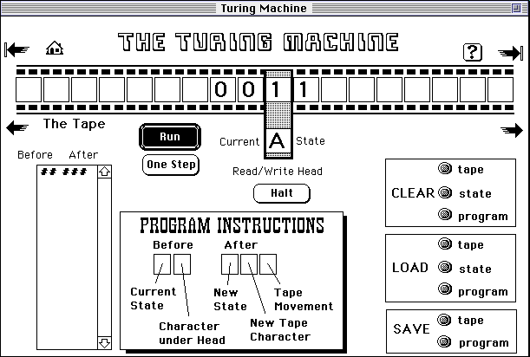
Turing Machines

Slide 21
Simple lambda calculus

Slide 22
Simple lambda calculus
λx[x 2 − 2·x + 5]

Slide 23
Simple lambda calculus
Variables: x, y,...
Abstraction: (λx.M)
Application: (M N)

Slide 24
Simple lambda calculus
Term := Variable
| (λVariable.Term) -- Abstraction
| (Term1 Term2) -- Application
(β-reduction) (λx.M)N ⊳ M[x := N]

Slide 25
Simple lambda calculus
0 := λf.λx.x
1 := λf.λx.f x
2 := λf.λx.f (f x)
3 := λf.λx.f (f (f x))
PLUS := λm.λn.λf.λx.m f (n f x)
Y := λg.(λx.g (x x)) (λx.g (x x))
TRUE := λx.λy.x
FALSE := λx.λy.y
AND := λp.λq.p q p
OR := λp.λq.p p q
NOT := λp.p FALSE TRUE
IFTHENELSE := λp.λa.λb.p a b

Slide 26
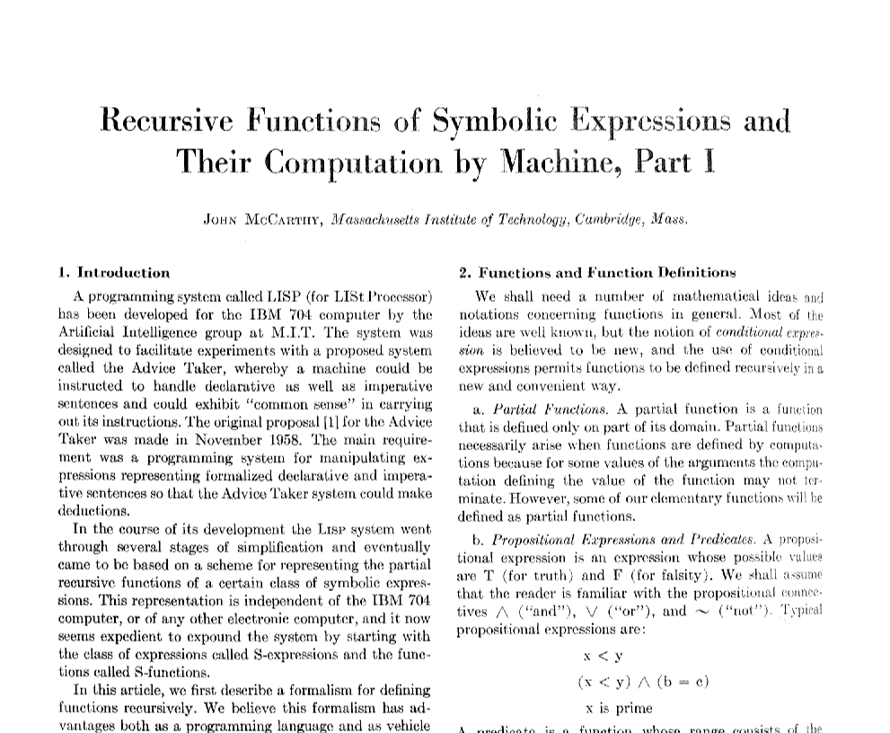
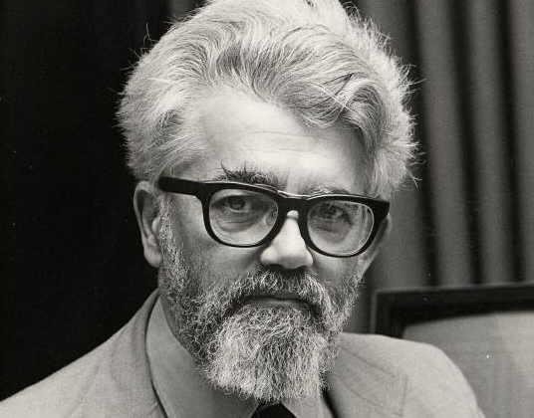
Simple lambda calculus: LISP

Slide 27
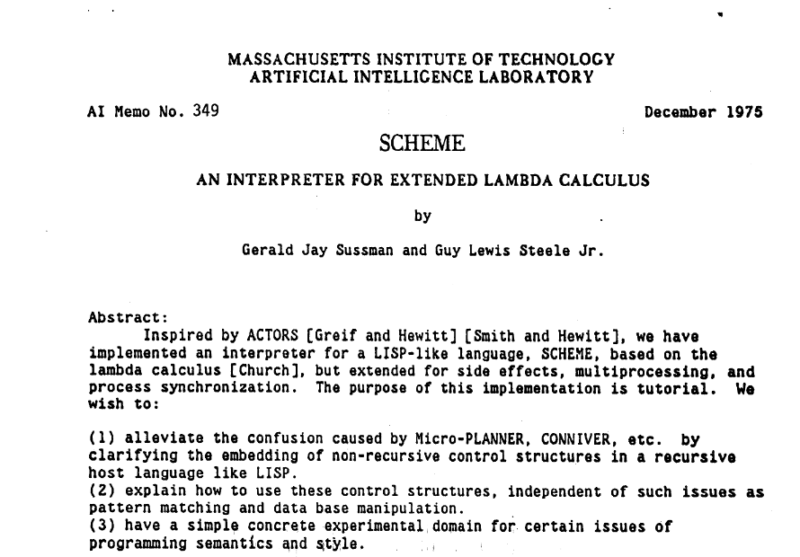
Simple lambda calculus: Scheme

Slide 28
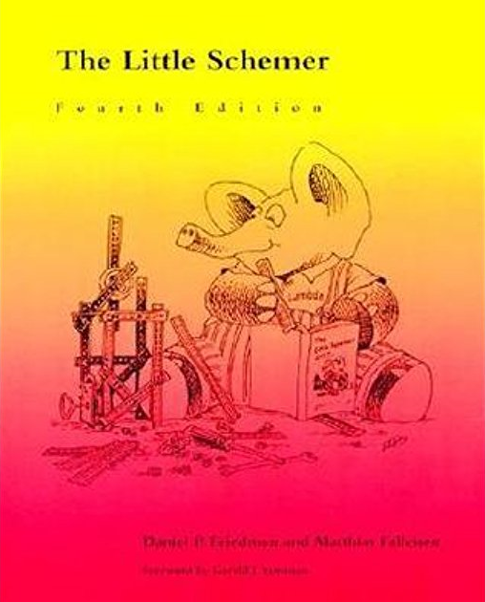
Simple lambda calculus: Scheme

Slide 29
Types
Russell paradox
Does the catalog of all catalogs that don’t include themselves contains itself?

Slide 30
Typed lambda calculus
Δ = λx. x x
ΔΔ = ?
ΔΔ = (λx. x x) (λx. x x)
reduces to
ΔΔ = (λx. x x) (λx. x x)

Slide 31

Typed lambda calculus
Terms
e ::= x | λx.e | (e1 e2 ) | c
x∈ Var c∈ Const
Types
t ::= t | t1→t2
t∈ TConst
Haskell Curry

Slide 32
Typed lambda calculus
Application:
N: A→B M: A
N M: B
Abstraction:
M: B [x: A]
λx. M: A → B
Is Strongly Normalizing (always terminates)

Slide 33
Typed lambda calculus
λx.λy.x : ?
λx. x x : ??
λx. ¬(x x) : ??
Is Strongly Normalizing
(programs always terminates)

Slide 34

Typed lambda calculus
System-F:
Polymorphic lambda calculus

Slide 35
Typed lambda calculus
System-F:
Polymorphic lambda calculus
Discovered by the logician Jean-Yves Girard
Discovered by the computer scientist John C. Reynolds

Slide 36
Typed lambda calculus
System-F:
Polymorphic lambda calculus
Discovered by the logician Jean-Yves Girard
Discovered by the computer scientist John C. Reynolds
The basis of ML and Haskell

Slide 37
x: A = (value of A) f: A->B = (function code) f(x): B = (value of B)

Slide 38
x: A = (value of A) f: A->B = (function code) f(x): B = (value of B)

Slide 39
x: A = (value of A) f: A->B = (function code) f(x): B = (value of B)

Slide 40
Curry-Howard equivalence

Slide 41
Curry-Howard isomorphism
Logic side | Programming side
universal quantification | generalised product type (Π type)
existential quantification | generalised sum type (Σ type)
implication | function type
conjunction | product type
disjunction | sum type
true formula | unit type
false formula | bottom type

Slide 42
Curry-Howard
Consequences:
Logic <-> Typing
Theorem provers

Slide 43
But there’s more!

Slide 44
Curry-Howard-Lambek

Slide 45
Category Theory

Slide 46
Category Theory
Things
Connections between things

Slide 47
Category Theory
Things
Connections between things
Identity
Composition

Slide 48
Category Theory
String
parseInt
Float
divByTwo
pack
Int
MyType

Slide 49
Category Theory
Functors
String
Float
Future a
Int
MyType

Slide 50
Category Theory
Functors
String
Future String
Float
Future Float
Int
Future Int
MyType
Future MyType

Slide 51
Category Theory
f:: String -> Int
g:: Int -> MyType
x = Future “1”
fmap f.g x
FUNCTOR

Slide 52
Category Theory
f:: String -> Maybe Int
g:: Int -> Maybe MyType
x = Just “1”
x >>= f >>= g
MONAD

Slide 53
“Computational trinitarianism”
“... The doctrine of computational trinitarianism holds that computation manifests itself in three forms: proofs of propositions, programs of a type, and mappings between structures. These three aspects give rise to three sects of worship: Logic, which gives primacy to proofs and propositions; Languages, which gives primacy to programs and types; Categories, which gives primacy to mappings and structures. The central dogma of computational trinitarianism holds that Logic, Languages, and Categories are but three manifestations of one divine notion of computation. There is no preferred route to enlightenment: each aspect provides insights that comprise the experience of computation in our lives…”
Bob Harper

Slide 54
“Computational trinitarianism”
Logic
Languages
Categories

Slide 55
Thanks!
gabriel@scalents.com

